Slide 1
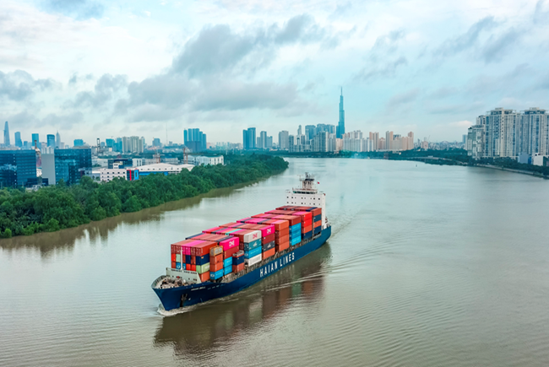
WELCOME TO OUR
HOCHIMINH CITY OFFICE
Our Main Services:
Port/Terminal/Depot operations, Normal/Bonded warehousing, Trucking…
Container transport Domestic & Regional
Liner agent, Logistics provider…

Slide 2
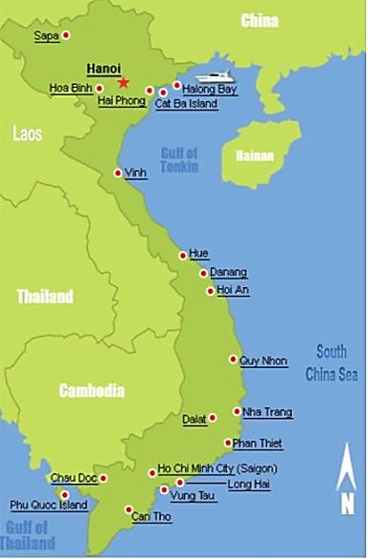
HEAD OFFICE
7th floor, 45 Trieu Viet Vuong Str., Hai Ba Trung Dist., Hanoi, Vietnam
Tel: +84 24 3987 6556/7515 Fax: +84 24 39744022
Website: www.haiants.vn Email: info@haiants.vn
SUBSIDIARIES
01
  HAI AN PORT CO., LTD
06
  HAIAN FREIGHT FORWARDING JSC
  1st FL, Hai An Building, Dinh Vu Road, Haiphong, Vietnam
  Tel: (84-225) 3979721- Fax: (84-225) 3979718 – (100%)
  R 502, Bldg 113 Thai Ha, Đong Đa – Hanoi , Vietnam
  Tel. (84-24) 6666 8888 – (36%)
02
  HAI AN CONTAINER TRANSPORT CO., LTD
07
  MARINA LOGISTICS CO., LTD
  5th FL, Hai An Building, Dinh Vu Road, Haiphong, Vietnam
  Tel. (84-225) 8830308 – Fax (84-225) 8830309 – (50.5%)
  6th FL, 45 Trieu Viet Vuong, HaNoi, VietNam.
  Tel. +84 2435776868 Fax +84 2435776868 – (20%)
03
  HAI AN AGENCY & LOGISTICS CO., LTD
08
  ZIM HAI AN JOINT VENTURE CO., LTD
  (Lotus Link Lines) – 2nd floor DinhVu Plaza, Dong Hai ward, Hai An district, Haiphong, Vietnam (51%)
  2nd FL, Hai An Building, Dinh Vu Road, Haiphong, Vietnam
  Tel: (84-225) 3260446- Fax: (84-225) 3260577 – (60%)
04
  PAN HAIAN (JV) CO., LTD.
09
  SM LINE VIETNAM
  6th FL, Haian Bldg, DinhVu Road, Haiphong, Vietnam
  Tel.(84-225) 8831575 Fax (84-225) 8831580 – (51%)
  7th FL, 217 Nguyen Van Thu, Da Kao ward, Distr.1 - HCM
  Tel. (84-28) 3823 3400 Fax (84-28) 3823 3362 – (100%)
05
  HAI AN GENERAL SERVICES JSC.
10
  BRANCH OFFICES
  3rd FL, Hai An Building, Dinh Vu Road, Haiphong, Vietnam
  Tel: (84-225) 3979725- Fax: (84-225) 3979734 – (38%)
  HOCHIMINH CITY: 7th FL, 217 Nguyen Van Thu, Da Kao ward, Distr.1 - HCM
  VUNG TAU: Khu A, lô 17 thị trấn Phú Mỹ, Q. Tân Thành, Bà Rịa Vũng Tàu, Viêt Nam
  DANANG: 3FL, 69 Quang Trung, Dist.Hải Châu, Đà Nẵng, Việt Nam

Slide 3
SHAREHOLDERS STRUCTURE
Updated
30 Jan. 2024

Slide 4
THE INCOME STATEMENT FROM 2016 TO 2023
Description | Unit | 2016 | 2017 | 2018 | 2019 | 2020 | 2021 | 2022 | 2023
Total output | Teu | 464.860 | 558.708 | 525.466 | 653.579 | 779.465 | 1.012.455 | 1.001.317 | 1.075.491
- Stevedoring | " | 323.343 | 381.987 | 305.755 | 312.152 | 346.934 | 416.779 | 417.278 | 427.057
- Transportation | " | 141.517 | 176.721 | 219.711 | 267.761 | 348.862 | 474.062 | 391.761 | 437.525
- Depot | " | - | - | - | 73.666 | 83.669 | 121.614 | 192.278 | 210.909
Contributed capital | Million VND | 231.962 | 345.078 | 487.828 | 487.828 | 487.828 | 487.828 | 700.345 | 1.055.169
Total asset | " | 966.320 | 1.309.509 | 1.655.980 | 1.827.544 | 2.094.551 | 3.232.345 | 5.049.419 | 5.358.949
Owner's Equity | " | 574.458 | 836.147 | 1.218.676 | 1.254.682 | 1.335.797 | 1.902.030 | 2.886.921 | 3.170.746
Total revenue | " | 487.582 | 777.930 | 1.054.283 | 1.108.933 | 1.191.667 | 1.955.301 | 3.205.610 | 2.612.690
Operating profit | " | 147.661 | 172.267 | 164.439 | 153.226 | 169.752 | 641.928 | 1.299.698 | 447.055
Net profit | " | 133.778 | 147.270 | 135.159 | 121.378 | 138.296 | 445.513 | 821.937 | 384.901
- Equivalent to US$ | USD | 5.889.394 | 6.477.678 | 5.814.541 | 5.743.770 | 6.364.131 | 24.320.466 | 35.110.514 | 15.984.245
ROA |  | 14,18% | 12,94% | 9,12% | 6,97% | 7,48% | 16,73% | 19,85% | 7,40%
ROE |  | 24,45% | 20,88% | 13,16% | 9,81% | 11,32% | 27,52% | 34,33% | 12,71%
ROS |  | 27,45% | 18,93% | 12,82% | 10,95% | 10,97% | 22,78% | 25,64% | 14,73%
(The exchange rates are determined at the end of calendar years)

Slide 6
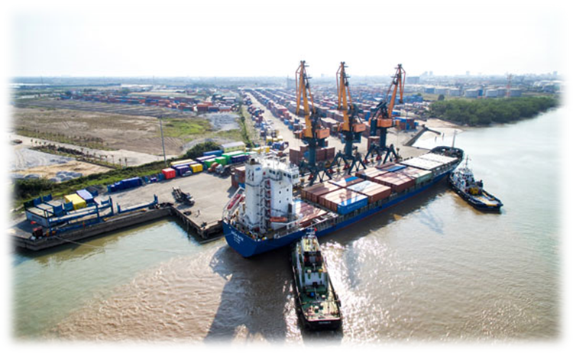
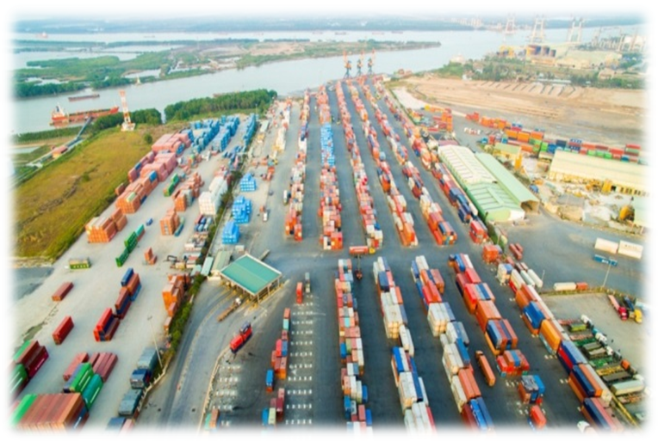
PORT OPERATIONS
2020: 347.000 TEU
2021: 416.700 TEU
2022: 417.000 TEU
2023: 427.000 TEU

Slide 7
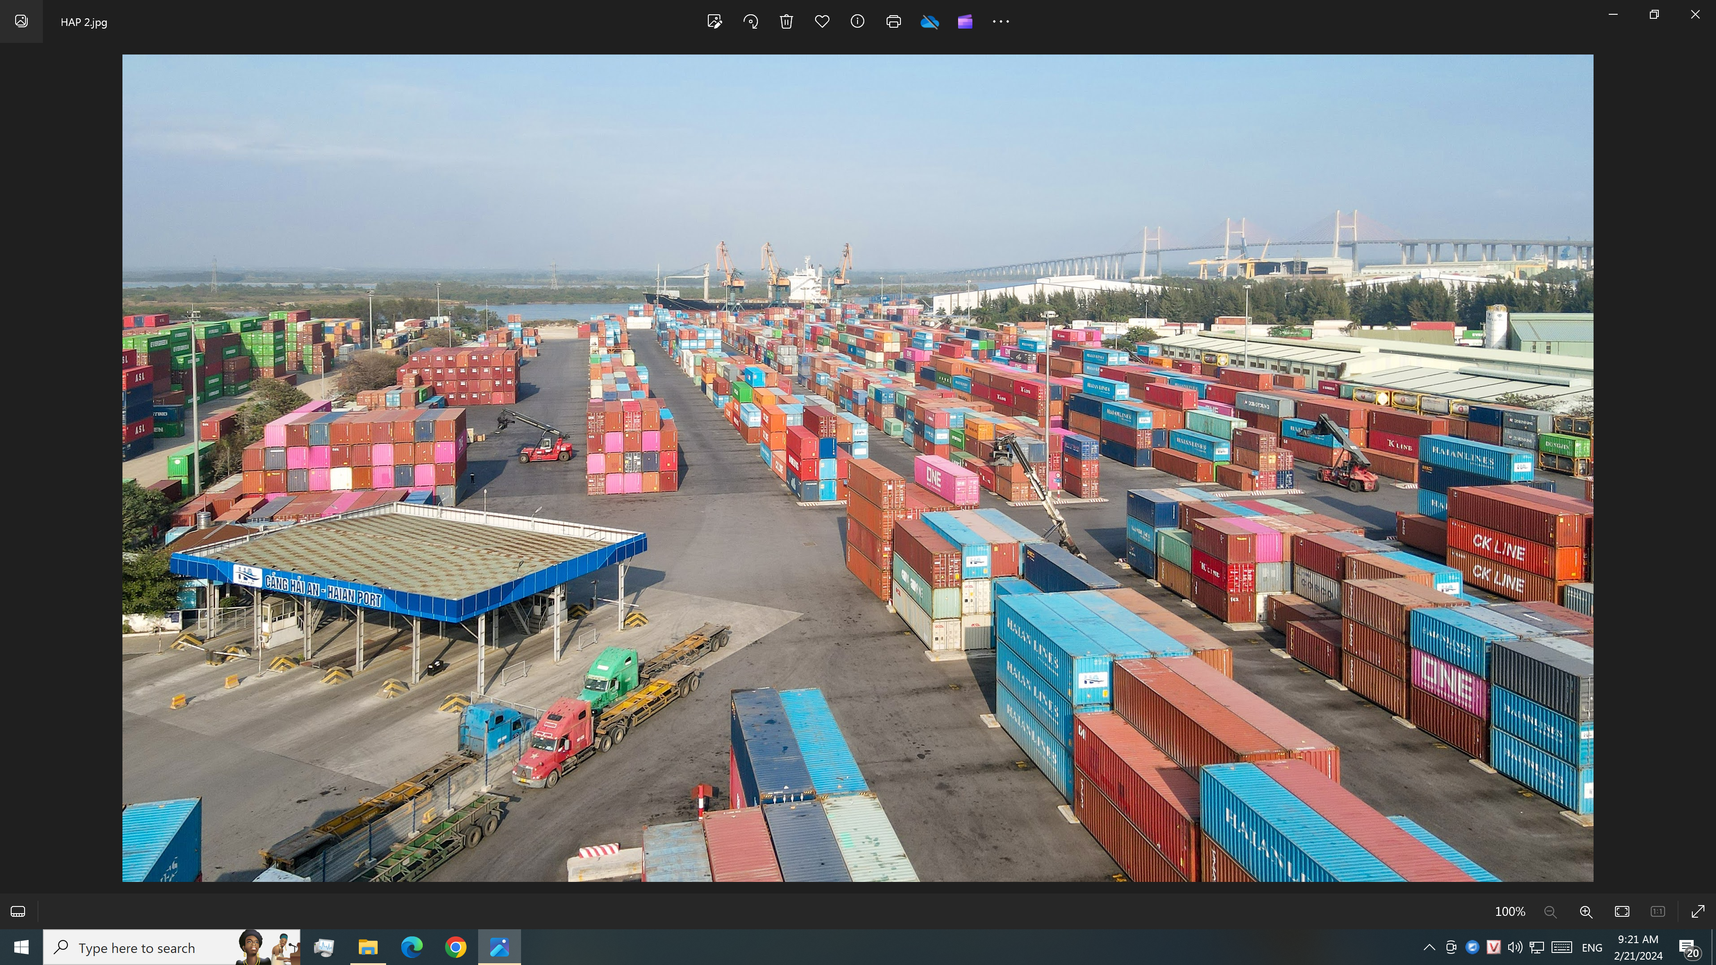

Slide 8
Hai Phong container throughput (in TEU)
TML Year | Nam Hai | Green Port | Chua Ve | TC-128 | Hai An | TC-189 | PTSC Dinh Vu | Dinh Vu | Tan Vu | Nam Hai-Dinh Vu | VIP- Green Port | Nam Dinh Vu | HICT | MIPEC | VIMC | Total | Growth (%)
2015 | 230,000 | 346,566 | 314,509 | 204,389 | 356,654 | 96,468 | 232,309 | 630,000 | 701,242 | 460,000 | 8,525 | nil | nil | nil | nil | 3,886,553 | 12.00
2016 | 221,898 | 280,000 | 198,951 | 250,000 | 323,343 | 107,961 | 168,000 | 803,362 | 852,238 | 523,484 | 280,156 | nil | nil | nil | nil | 4,258,883 | 9.58
2017 | 163,800 | 278,274 | 149,178 | 381,000 | 381,987 | 140,479 | 293,660 | 688,170 | 953,877 | 629,498 | 453,924 | nil | nil | nil | nil | 4,574,174 | 7.40
2018 | 176,842 | 324,379 | 261,000 | 323,591 | 305,755 | 142,692 | 320,312 | 658,134 | 890,000 | 568,137 | 641,322 | 184,531 | 64,920 | nil | nil | 4,976,221 | 8.79
2019 | 140,643 | 241,531 | 300,861 | 228,632 | 312,152 | 108,956 | 350,321 | 539,816 | 979,887 | 455,803 | 645,277 | 333,872 | 433,515 | nil | nil | 5,120,018 | 2.89
2020 | 99,167 | 227,413 | 320,286 | 142,063 | 346,964 | 136,262 | 341,515 | 548,679 | 952,927 | 534,303 | 587,700 | 257,849 | 664,365 | 8,950 | nil | 5,186,096 | 1.29
2021 | 130,440 | 272,249 | 337,337 | 194,625 | 416,779 | 141,272 | 278,880 | 592,750 | 1,063,297 | 531,249 | 635,646 | 380,780 | 696,076 | 28,302 | nil | 5,699,682 | 9.90
2022 | 160,954 | 283,815 | 236,109 | 235,676 | 417,278 | 159,435 | 208,525 | 543,534 | 1,075,338 | 555,125 | 664,213 | 382,031 | 1,181,464 | 94,571 | 96 | 6,198,164 | 8.75
2023 | 25,378 | 262,217 | 286,812 | 204,881 | 427,057 | 172,860 | 269,939 | 478,600 | 951,507 | 262,038 | 616,671 | 900,958 | 1,272,816 | 80,907 | 61,071 | 6,273,712 | 1.22
Design capacity | 250,000 | 500,000 | 750,000 | 500,000 | 350,000 | 200,000 | 300,000 | 600,000 | 1,250,000 | 600,000 | 600,000 | 500,000 | 1,200,000 | 300,000 | 300,000 | 8,570,000
ESTIMATED HAIPHONG CONTAINER THROUGHPUT
Year | 2018 | 2021 | 2022 | EST 2023 | EST 2024 | EST 2025 | EST 2026 | EST 2027 | EST 2028 | EST 2029 | EST 2030
Throughput (TEU) | 4,976,221 | 5,699,682 | 6,198,164 | 6,273,712 | 6,587,398 | 6,916,767 | 7,262,606 | 7,625,736 | 8,007,023 | 8,407,374 | 8,827,743
Growth (%) | 8.79 | 9.9 | 8.75 | 1.22 | 5 | 5 | 5 | 5 | 5 | 5 | 5

Slide 9
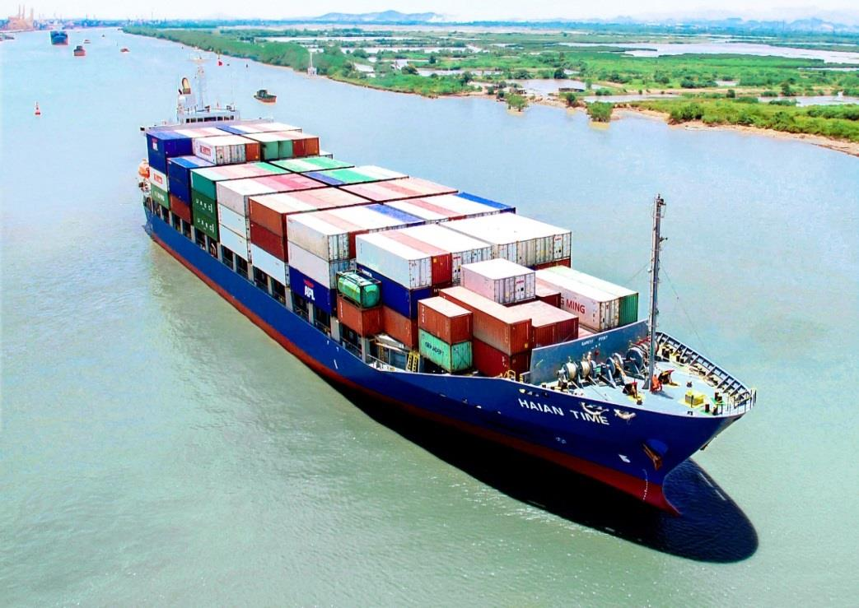

CONTAINER TRANSPORT SERVICES
Annual Volume
348.862 TEU
474.062 TEU
392.000 TEU
437.000 TEU
(XNK: 105.000 – Dom. 322.000)

Slide 10
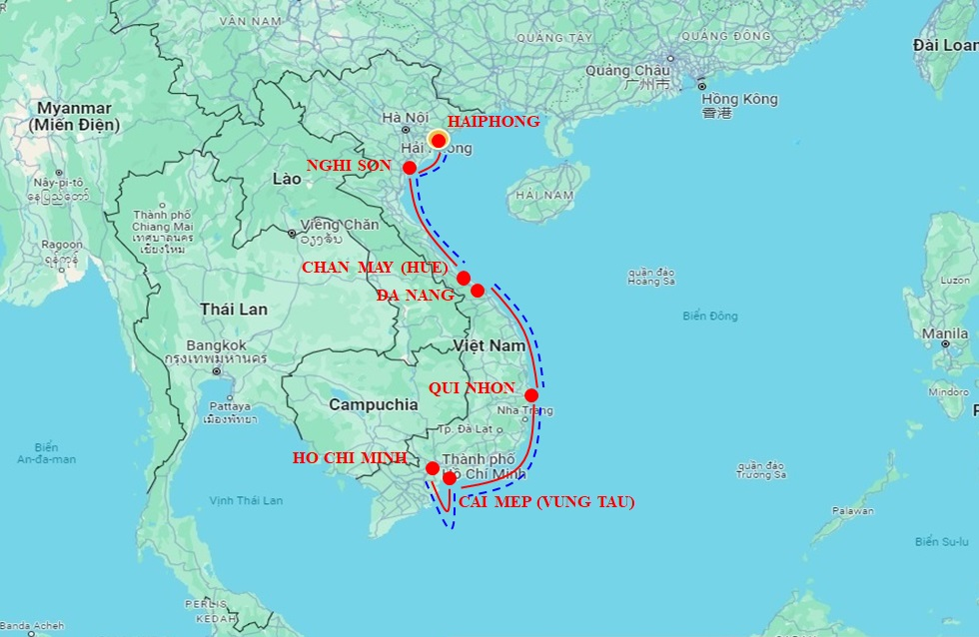
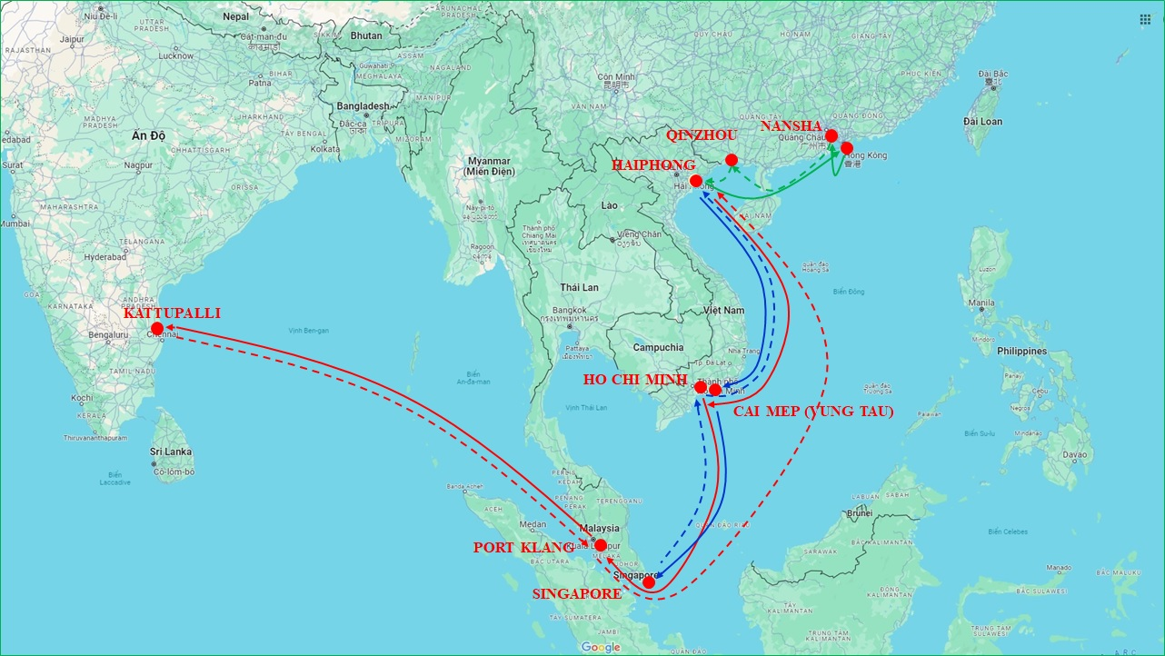
DOMESTIC SERVICES
HPH-NGS-DAN/CAM-HCM-HPH
HPH-CMP-HCM-DAN-HPH
HPH-DAN-HCM-HPH
REGIONAL SERVICES
HPH-HKG-NSH-QIZ-HPH
HPH-CMP-HCM-SIN-HCM-HPH
HPH-HCM-PKL-KAT-CLA-HPH

Slide 11
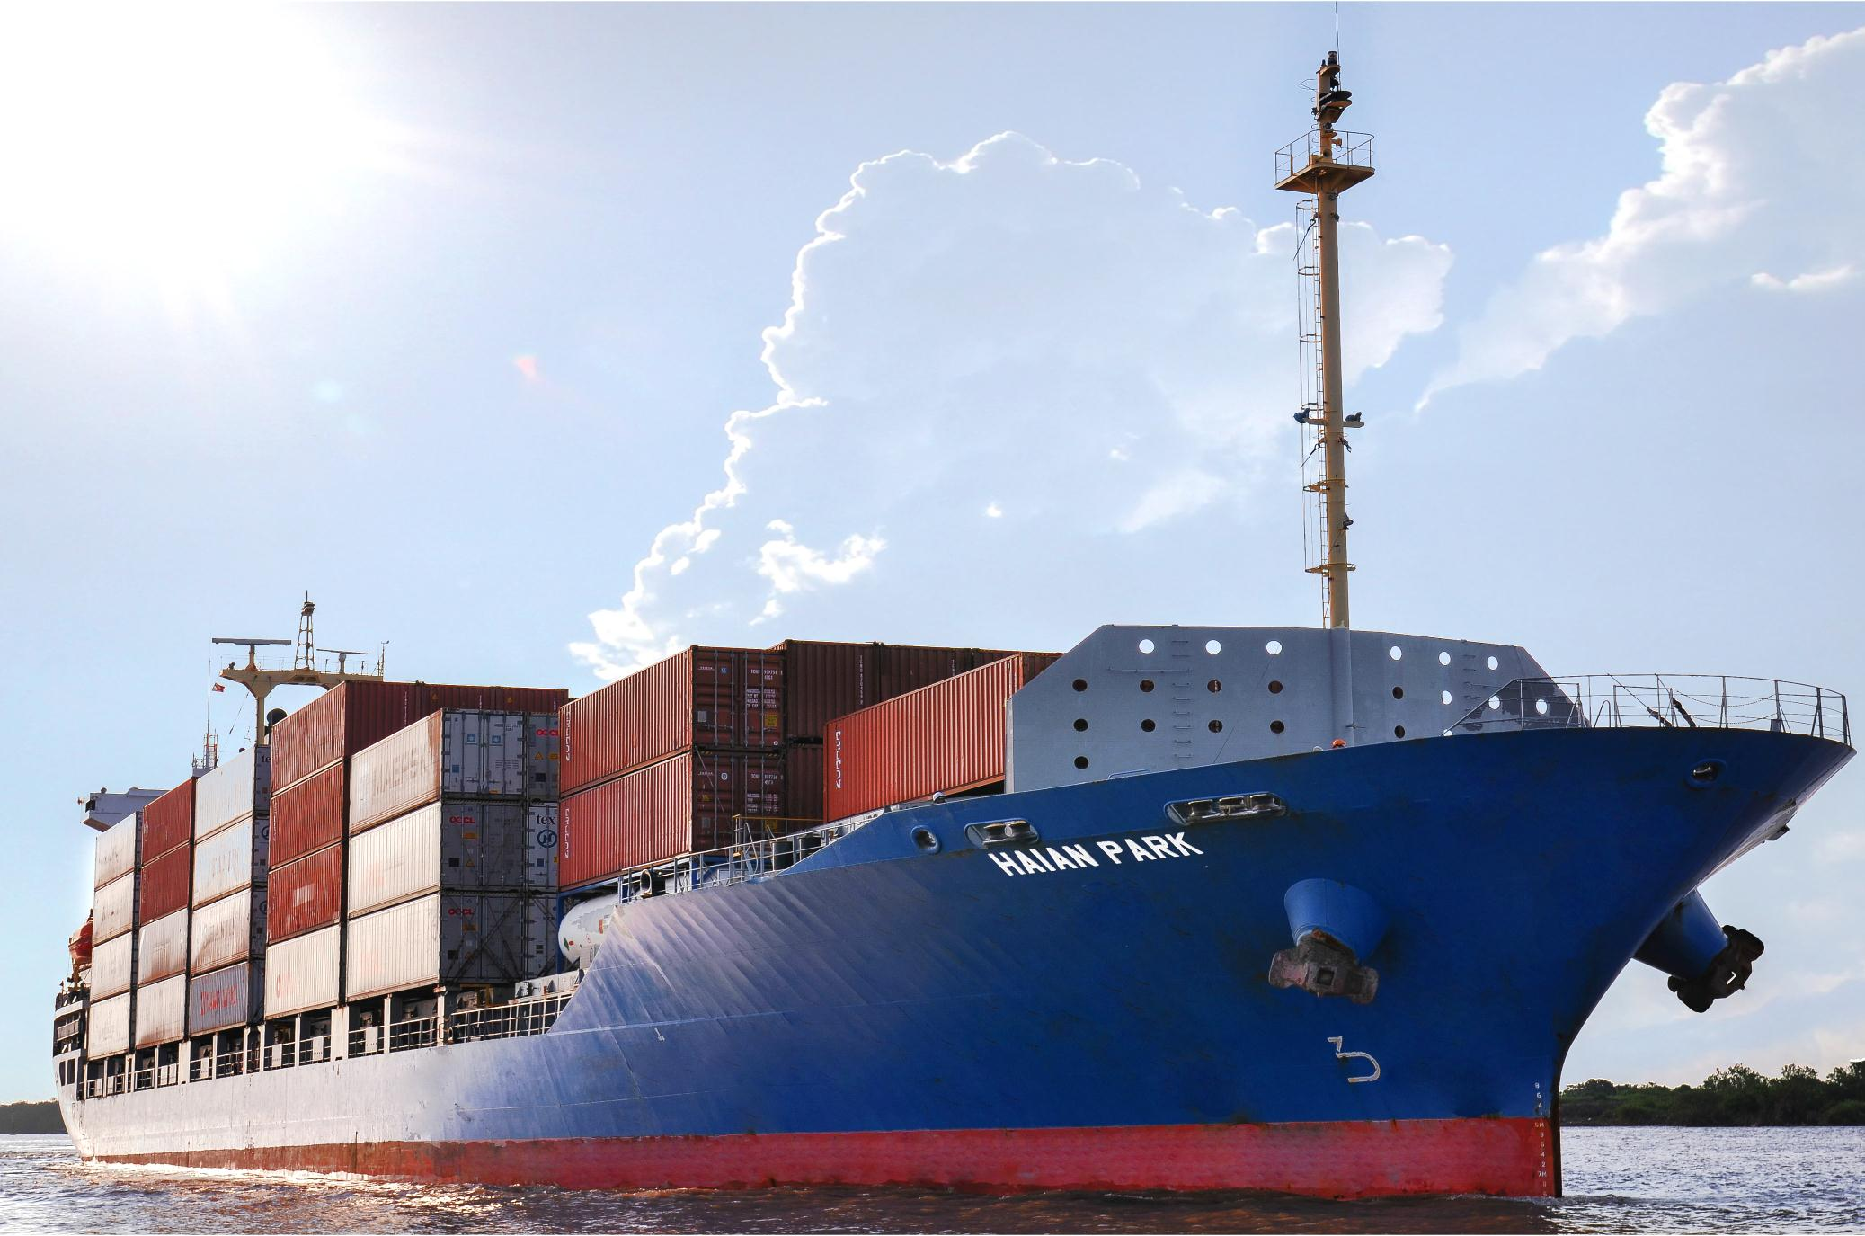
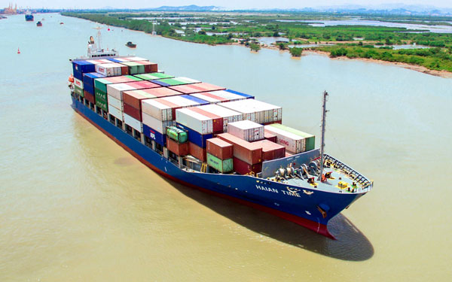
2014
2015
MV “HAIAN PARK” – 787 TEU
MV “HAIAN TIME” – 1.032 TEU
www.haiants.vn
            HaiAn Transport and Stevedoring JSC

Slide 12
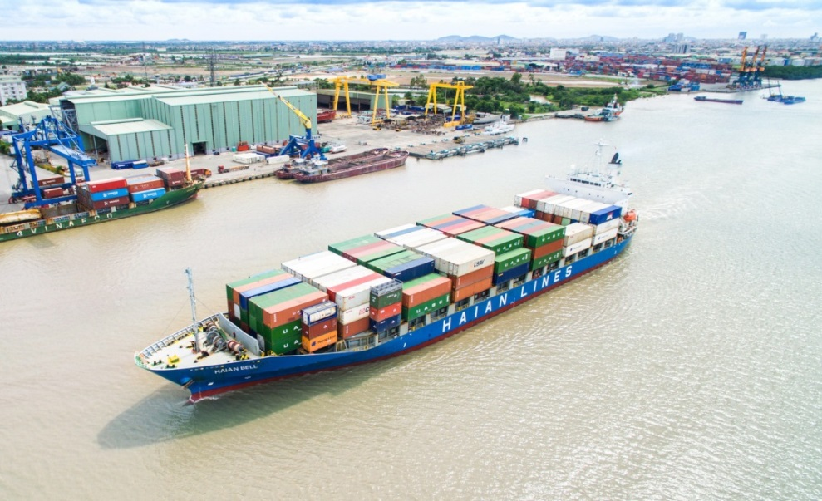
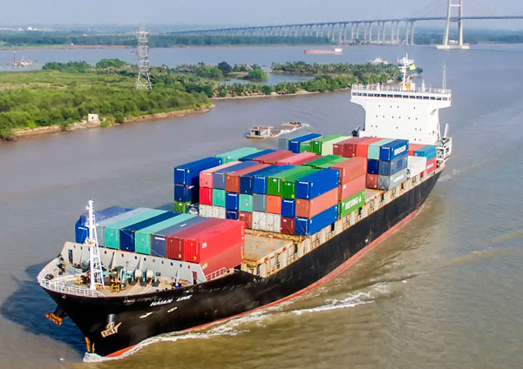
2017
2018
MV “HAIAN BELL” – 1.200 TEU
MV “HAIAN LINK” – 1060 TEU
www.haiants.vn
            HaiAn Transport and Stevedoring JSC

Slide 13
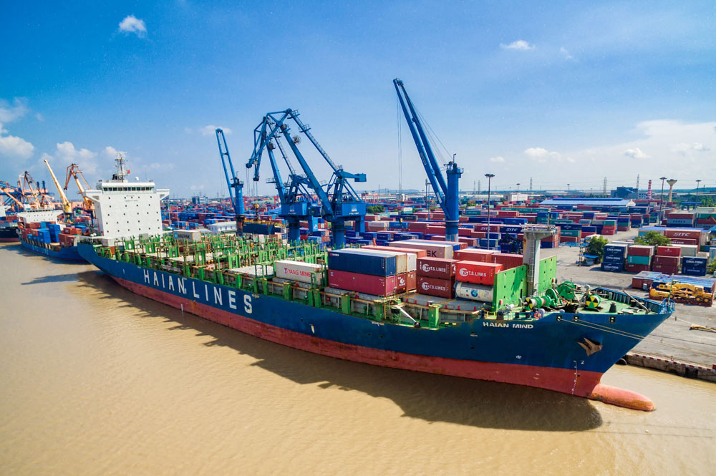
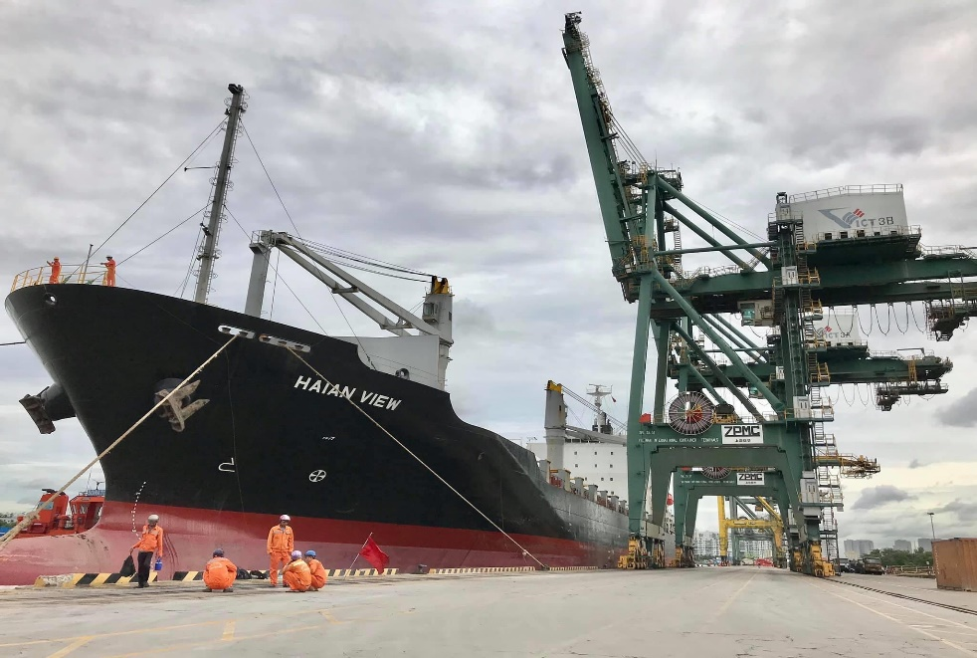
2020
2019
MV “HAIAN MIND” – 1.794 TEU
MV “HAIAN VIEW” – 1.577 TEU
www.haiants.vn
            HaiAn Transport and Stevedoring JSC

Slide 14
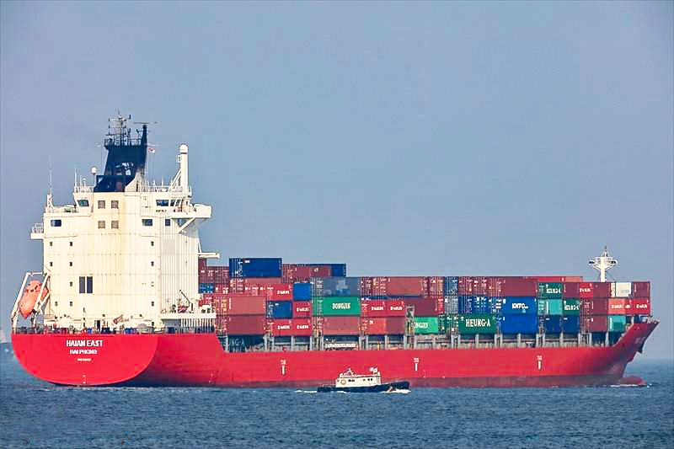
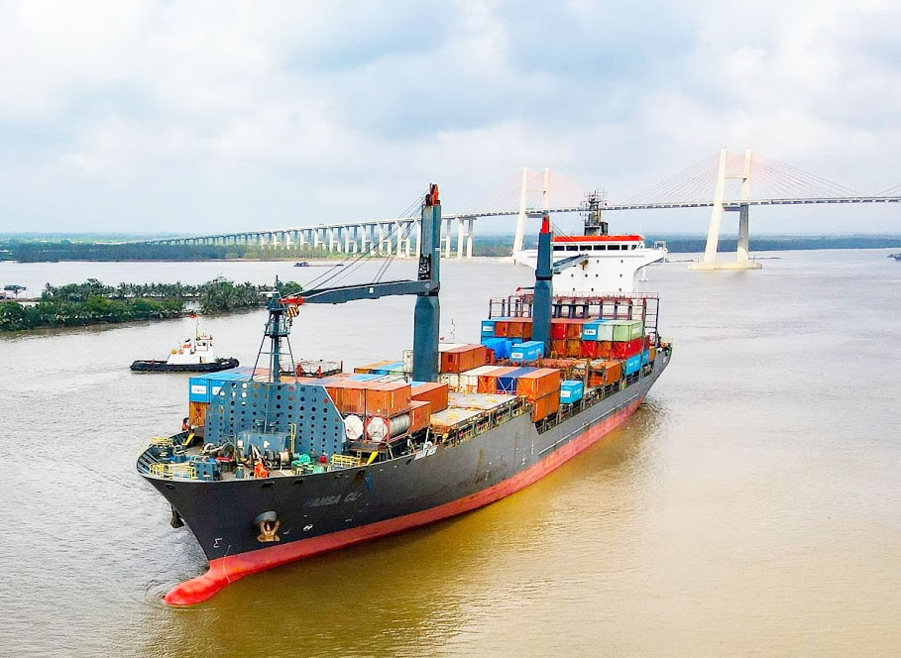
2021
2021
MV “HAIAN EAST” – 1.702 TEU
MV “HAIAN WEST” – 1740 TEU
www.haiants.vn
            HaiAn Transport and Stevedoring JSC

Slide 15
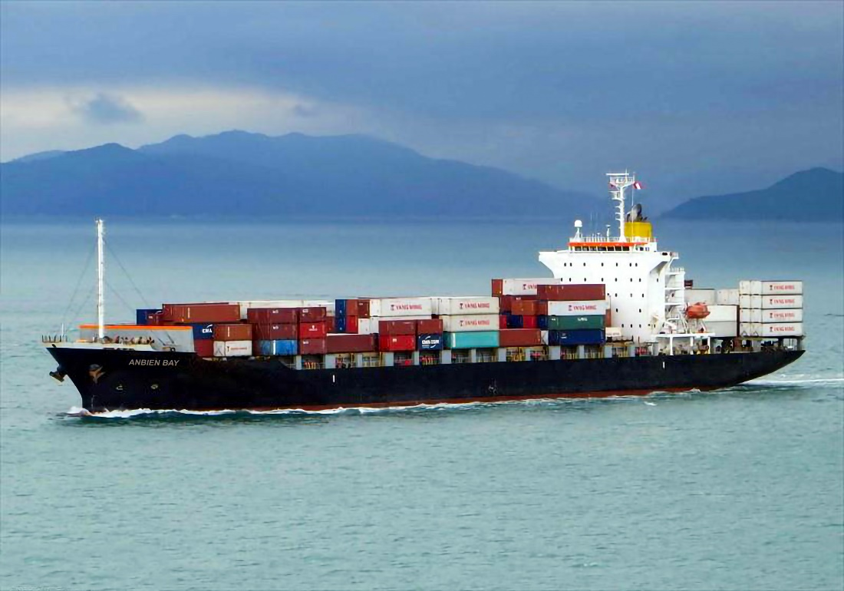
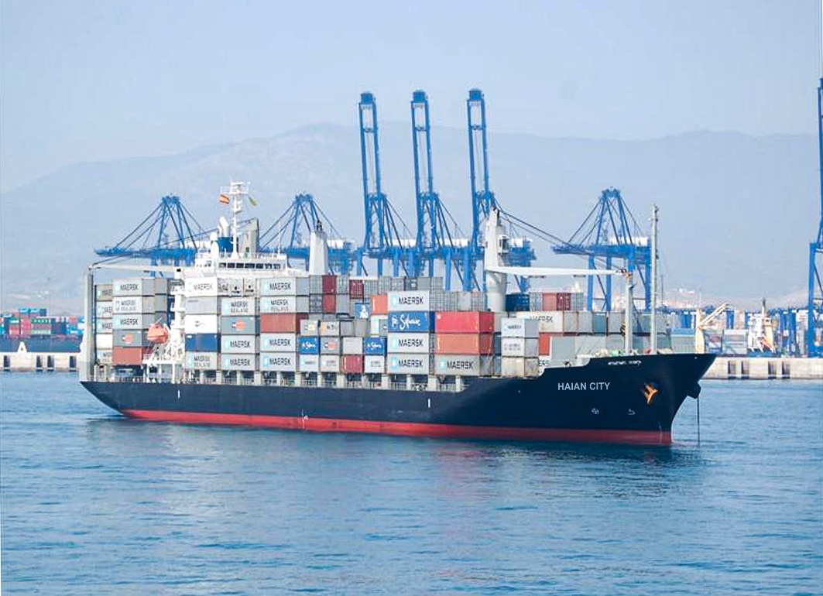
2022
2022
MV “ANBIEN BAY” – 1.702 TEU
MV “HAIAN CITY” – 1.577 TEU
www.haiants.vn
            HaiAn Transport and Stevedoring JSC

Slide 16
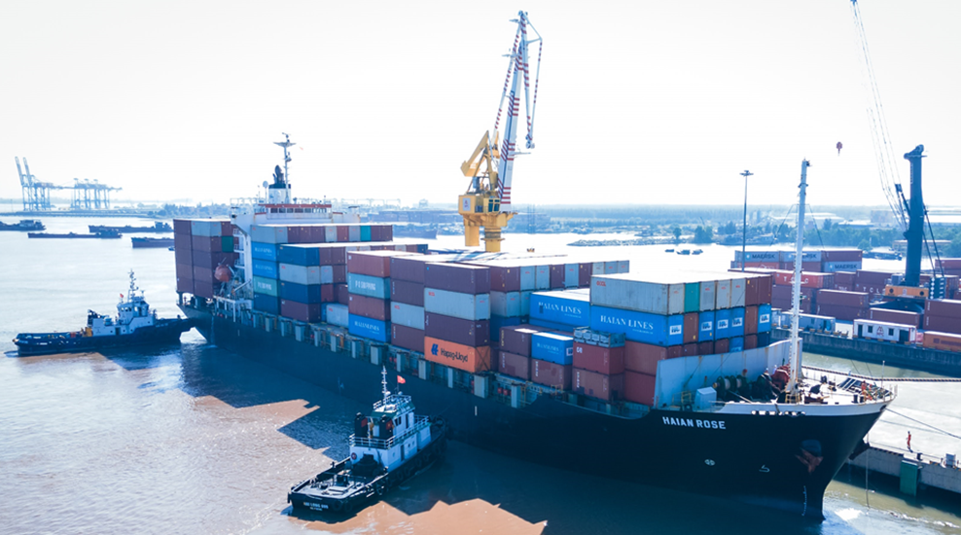
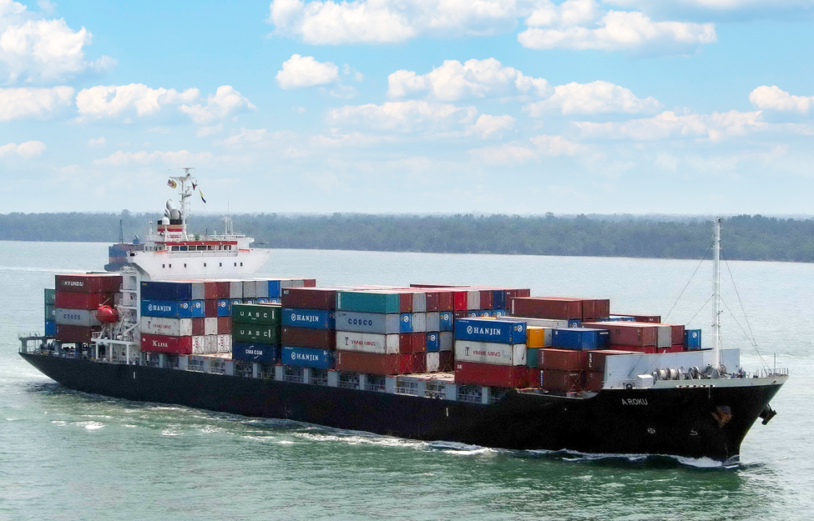
2022
MV HAIAN ROSE – 1708 TEU IN VICT

Slide 17
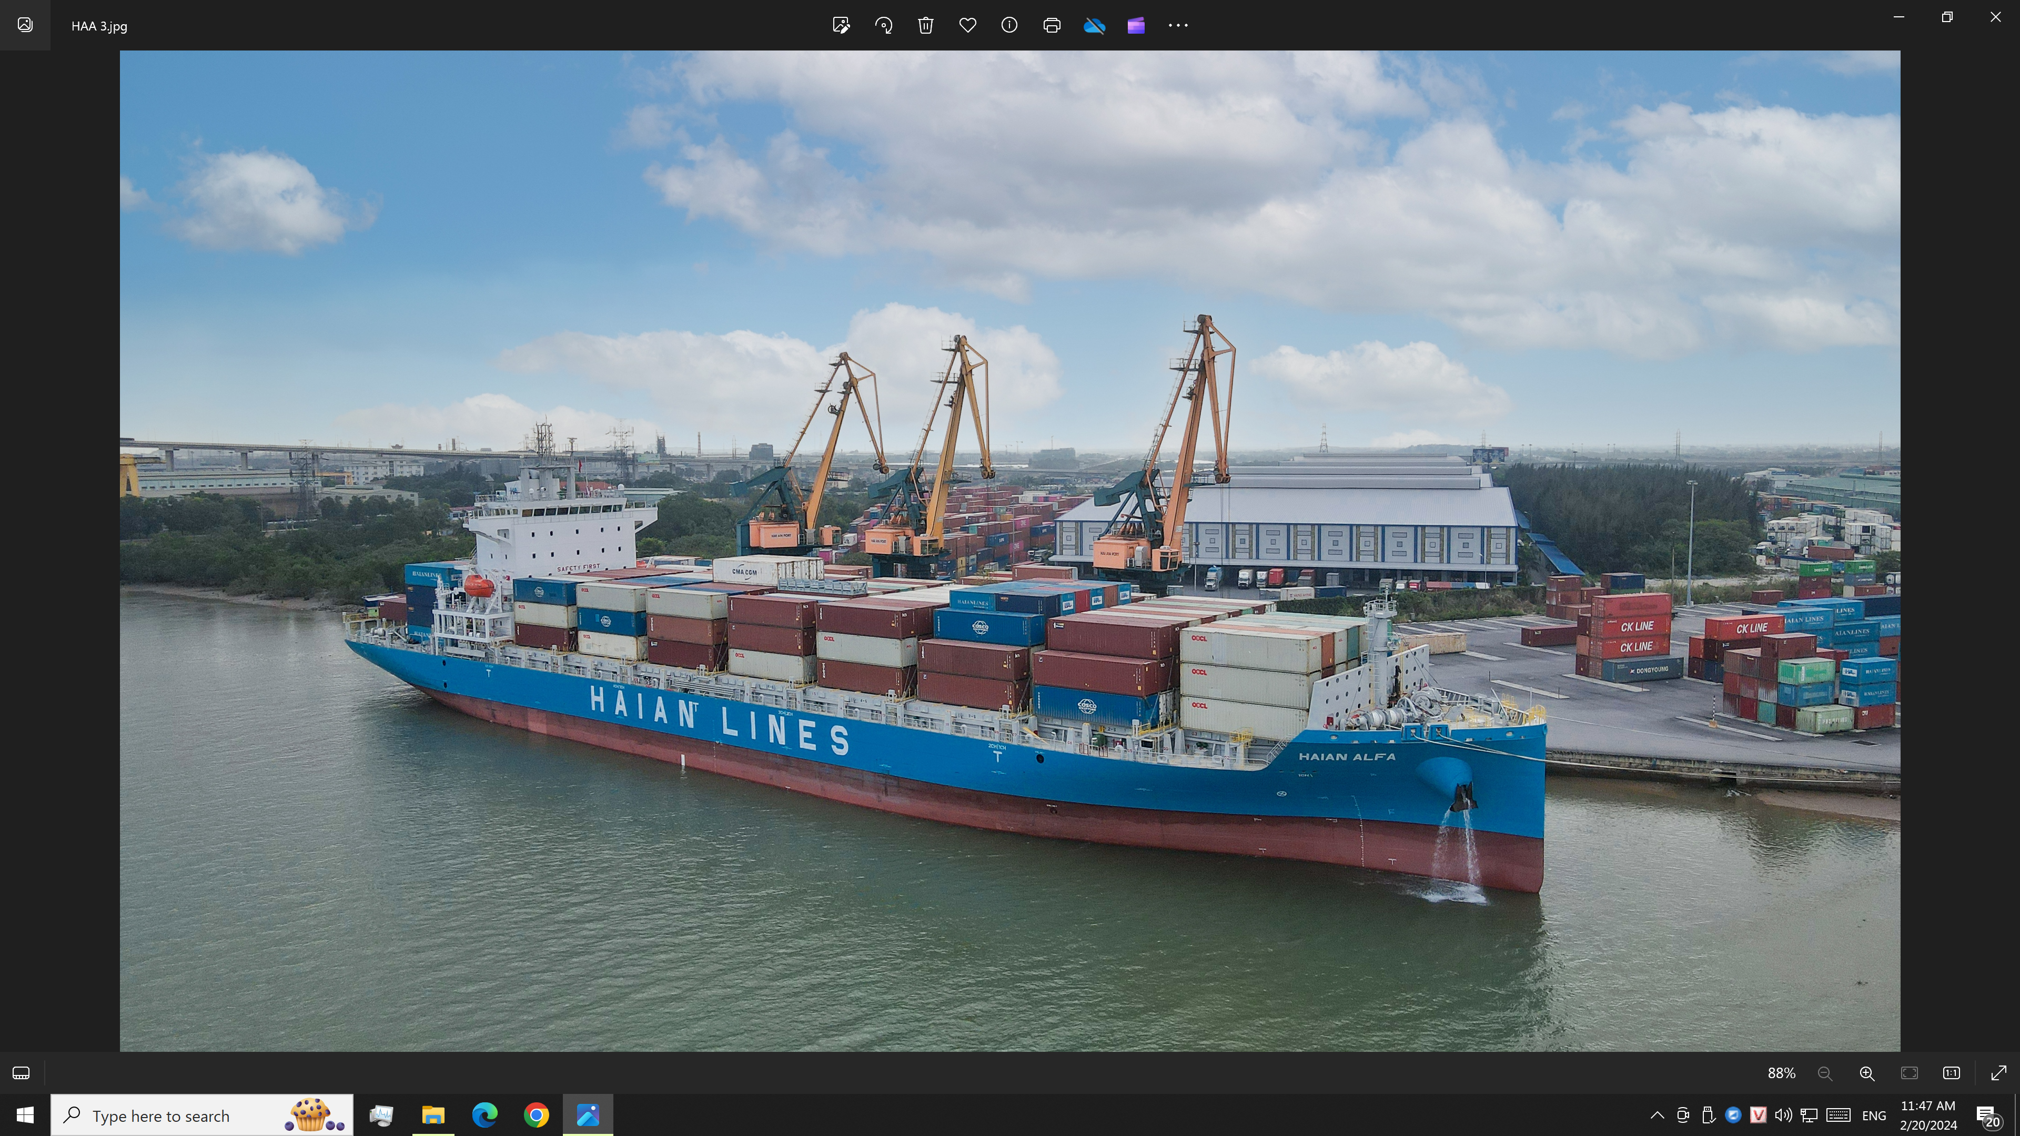
NEW BUILDING VESELS: 04 BANGKOK MARK IV 1800 TEU TIER II
HAIAN ALFA: Dec. 2023
HAIAN BETA: Apr. 2024
ANBIEN SKY: Jun. 2024
HAIAN OPUS: Jul. 2024

Slide 18
Development Plan
Dec. 2023: 1 x 1800 TEU New Bld.
Total 2023: 12 vsls – 17.685 TEU
Apr. 2024: 1 x 1800 TEU NB
Jun. 2024: 1 x 1800 TEU NB
Jul. 2024: 1 x 1800 TEU NB
Total 2024: 15 vsls – 23.009 TEU
Operations Plan
Develop Domestic services (increase sailings & Port of calls >> Volume)
Open two Regional services in Seasia (VN/Sin & VN/East India).
Charter out some Economic vessels for increasing USD earnings.

Slide 19
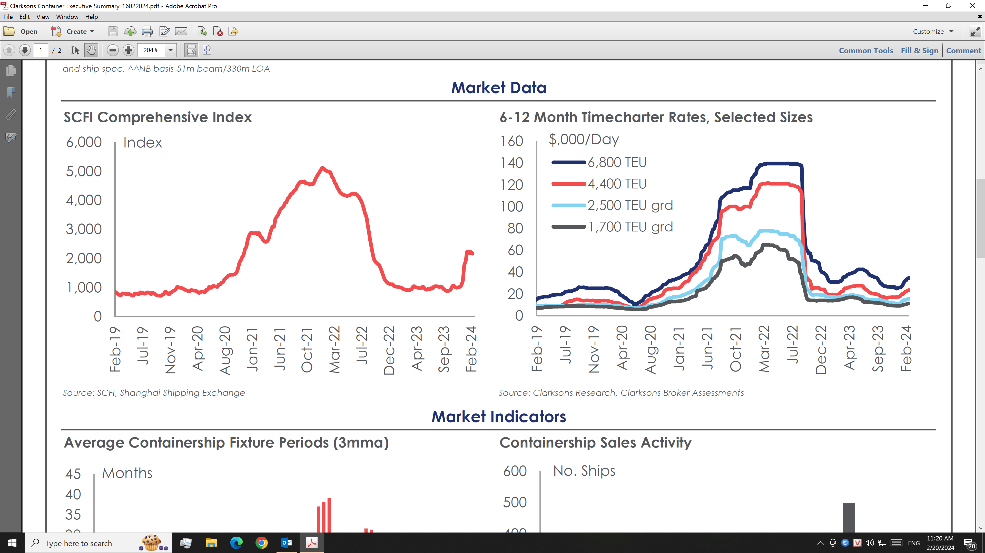
MARKET TREND & OUR PLAN

Slide 20
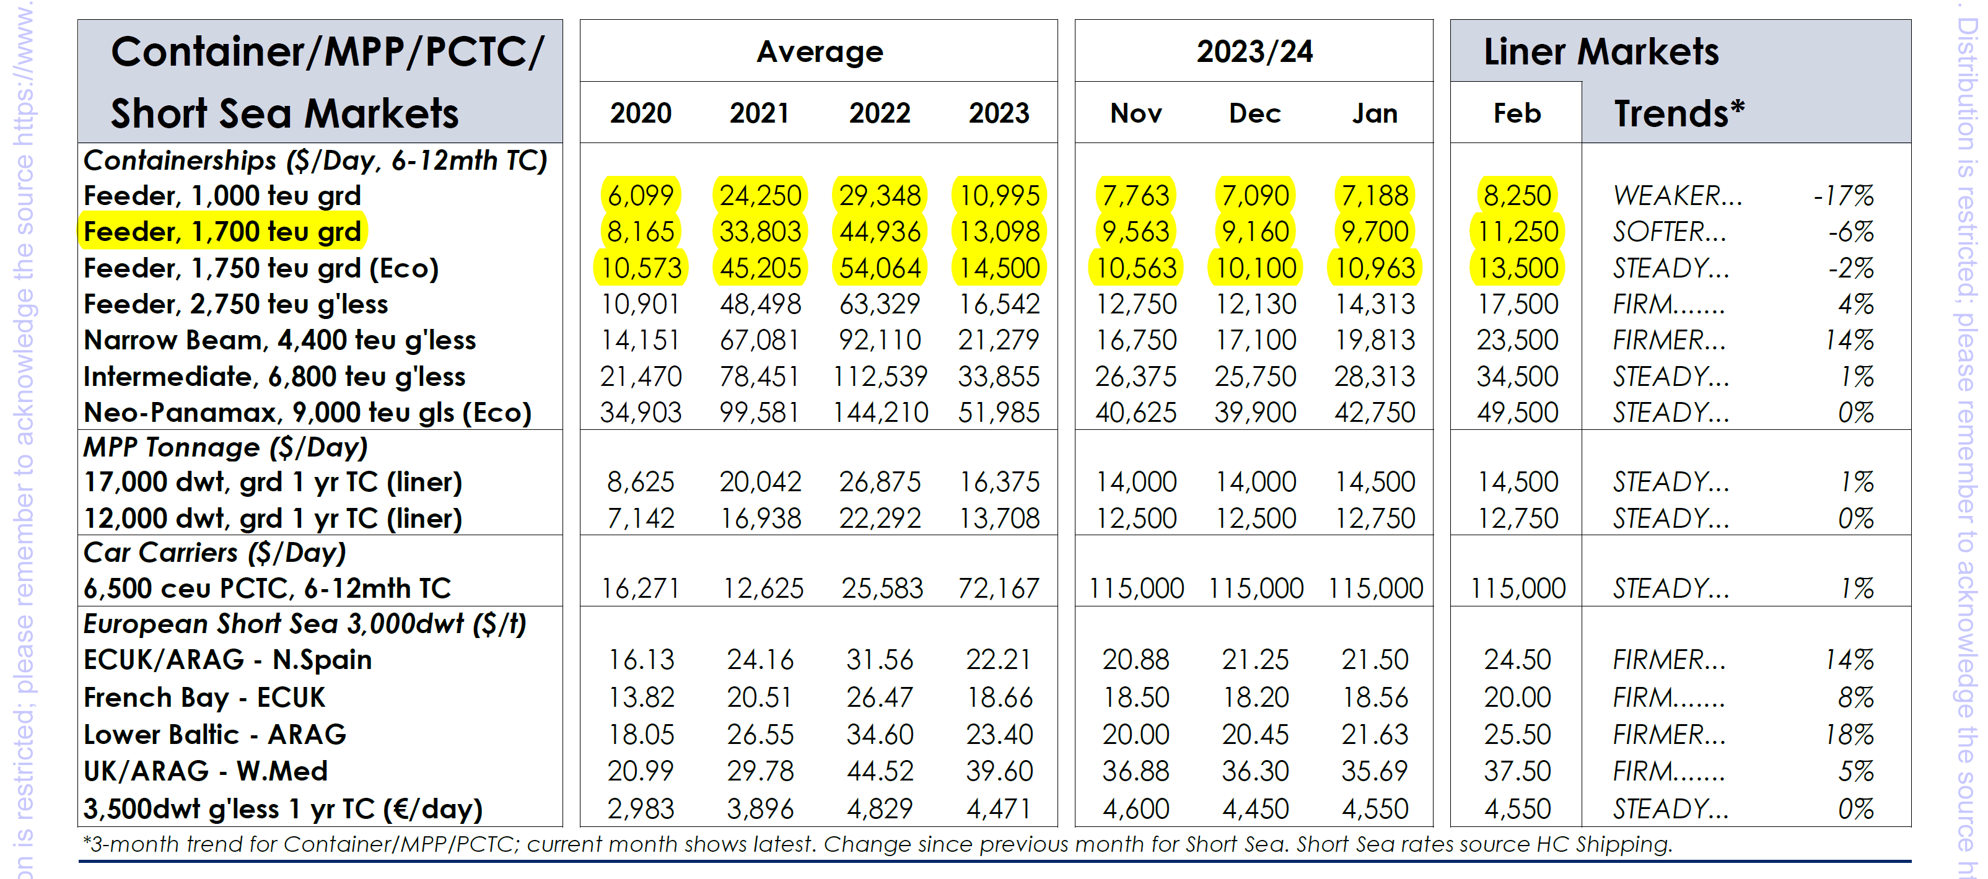
ANNUAL CHARTER RATES - CLARKSONS

Slide 21
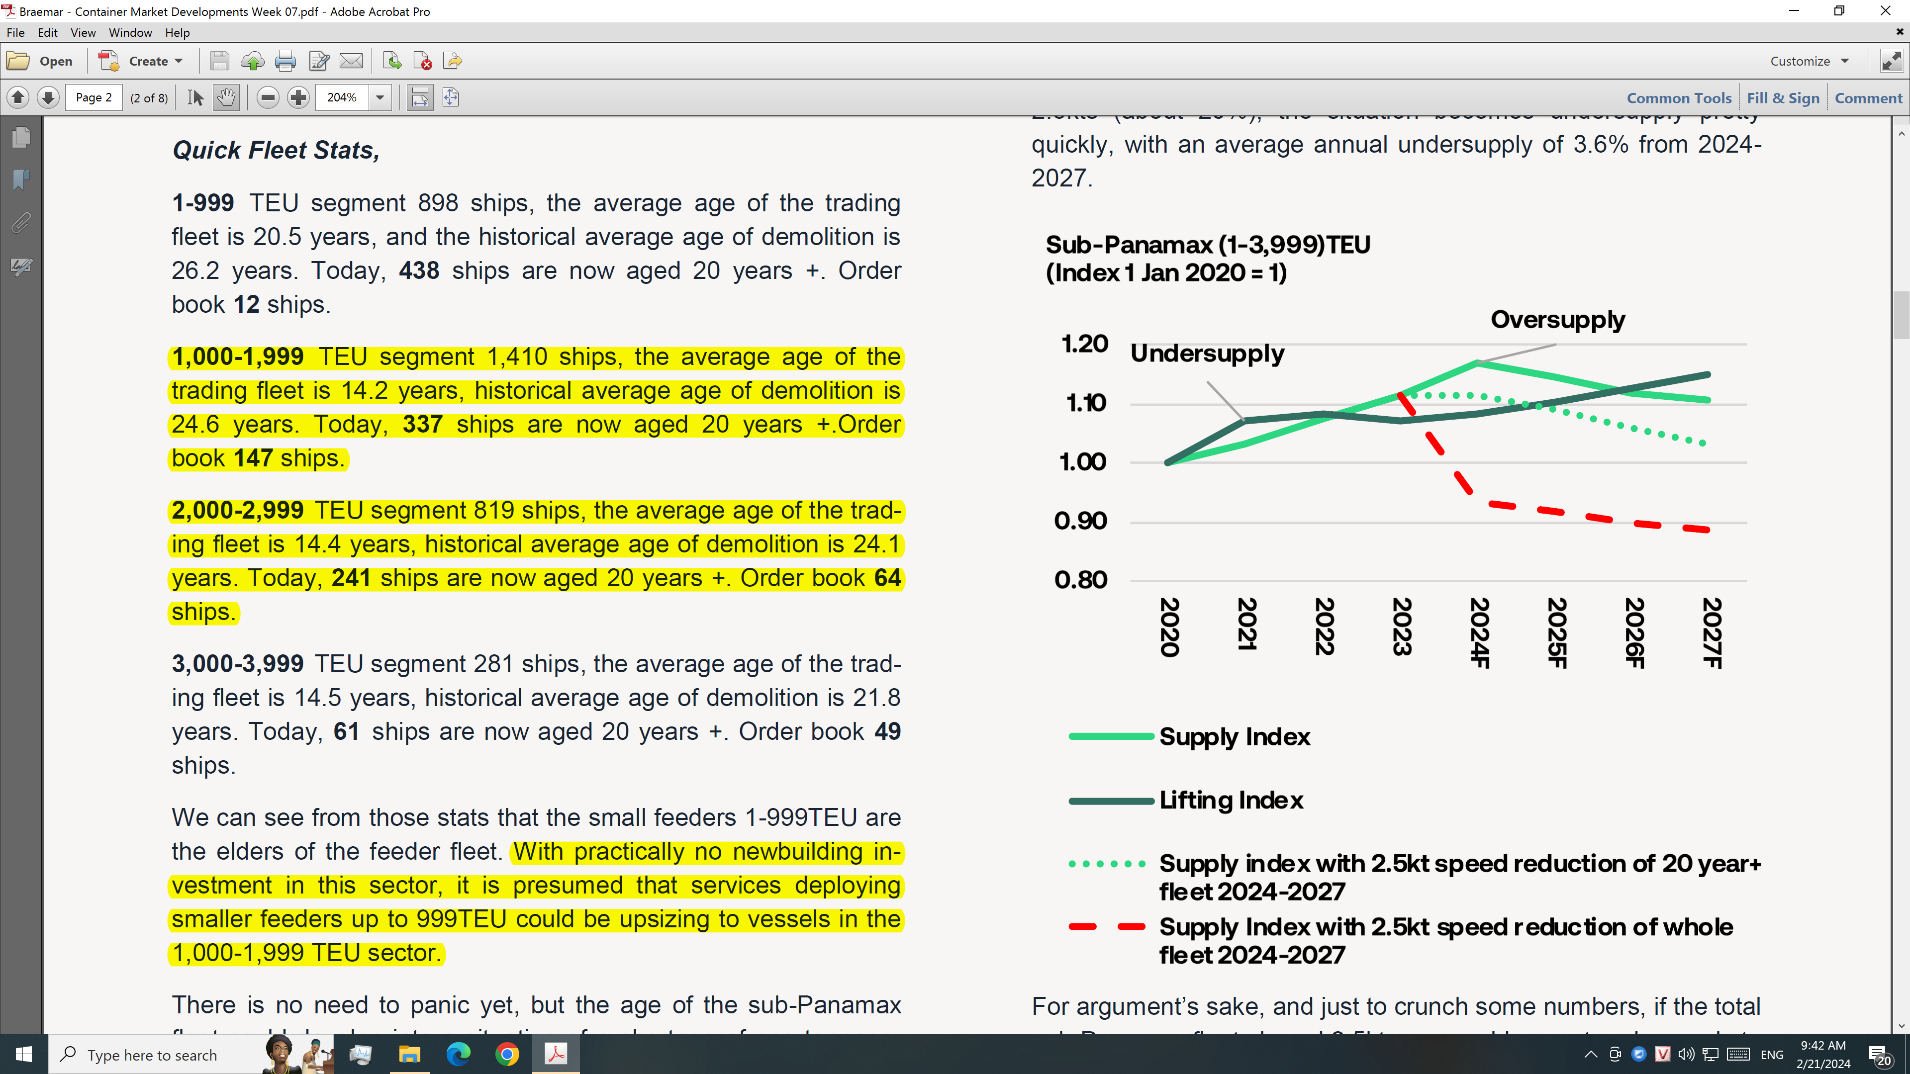
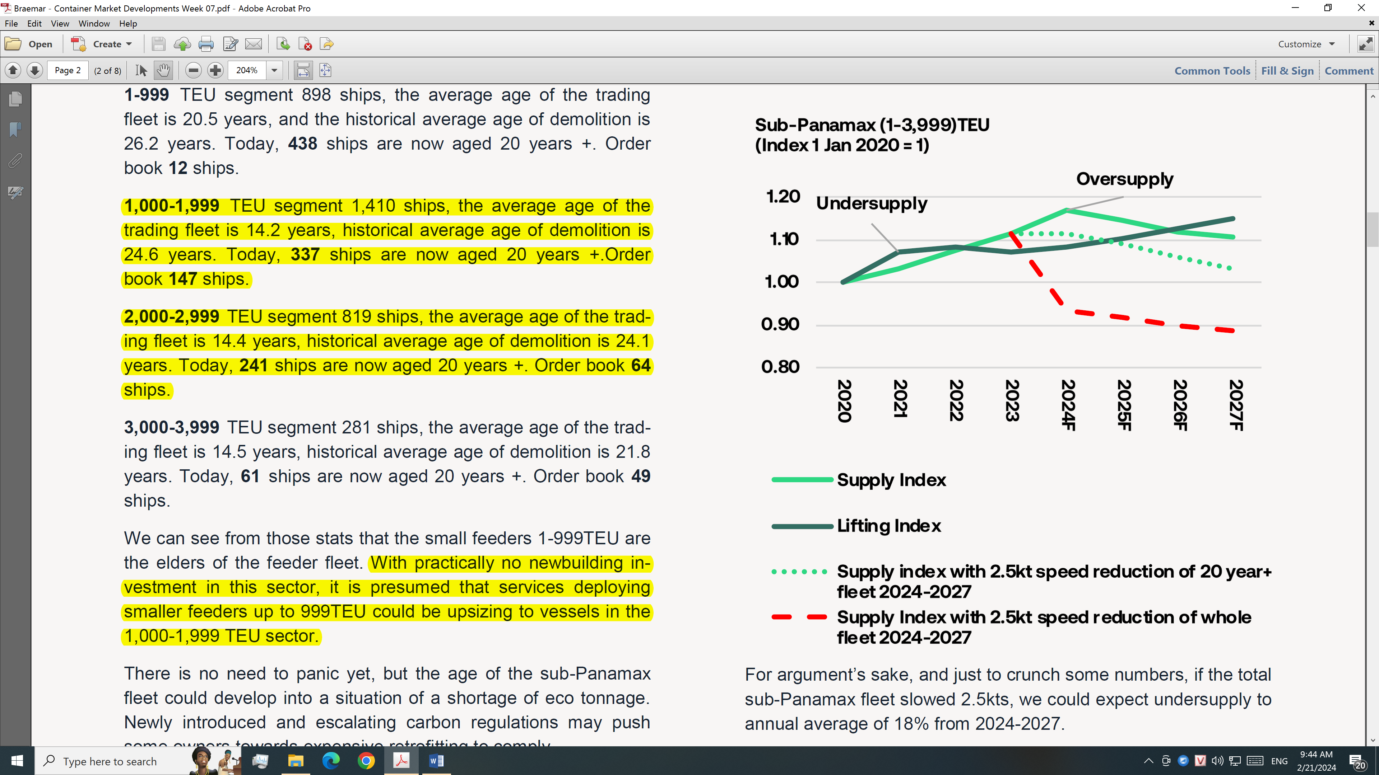
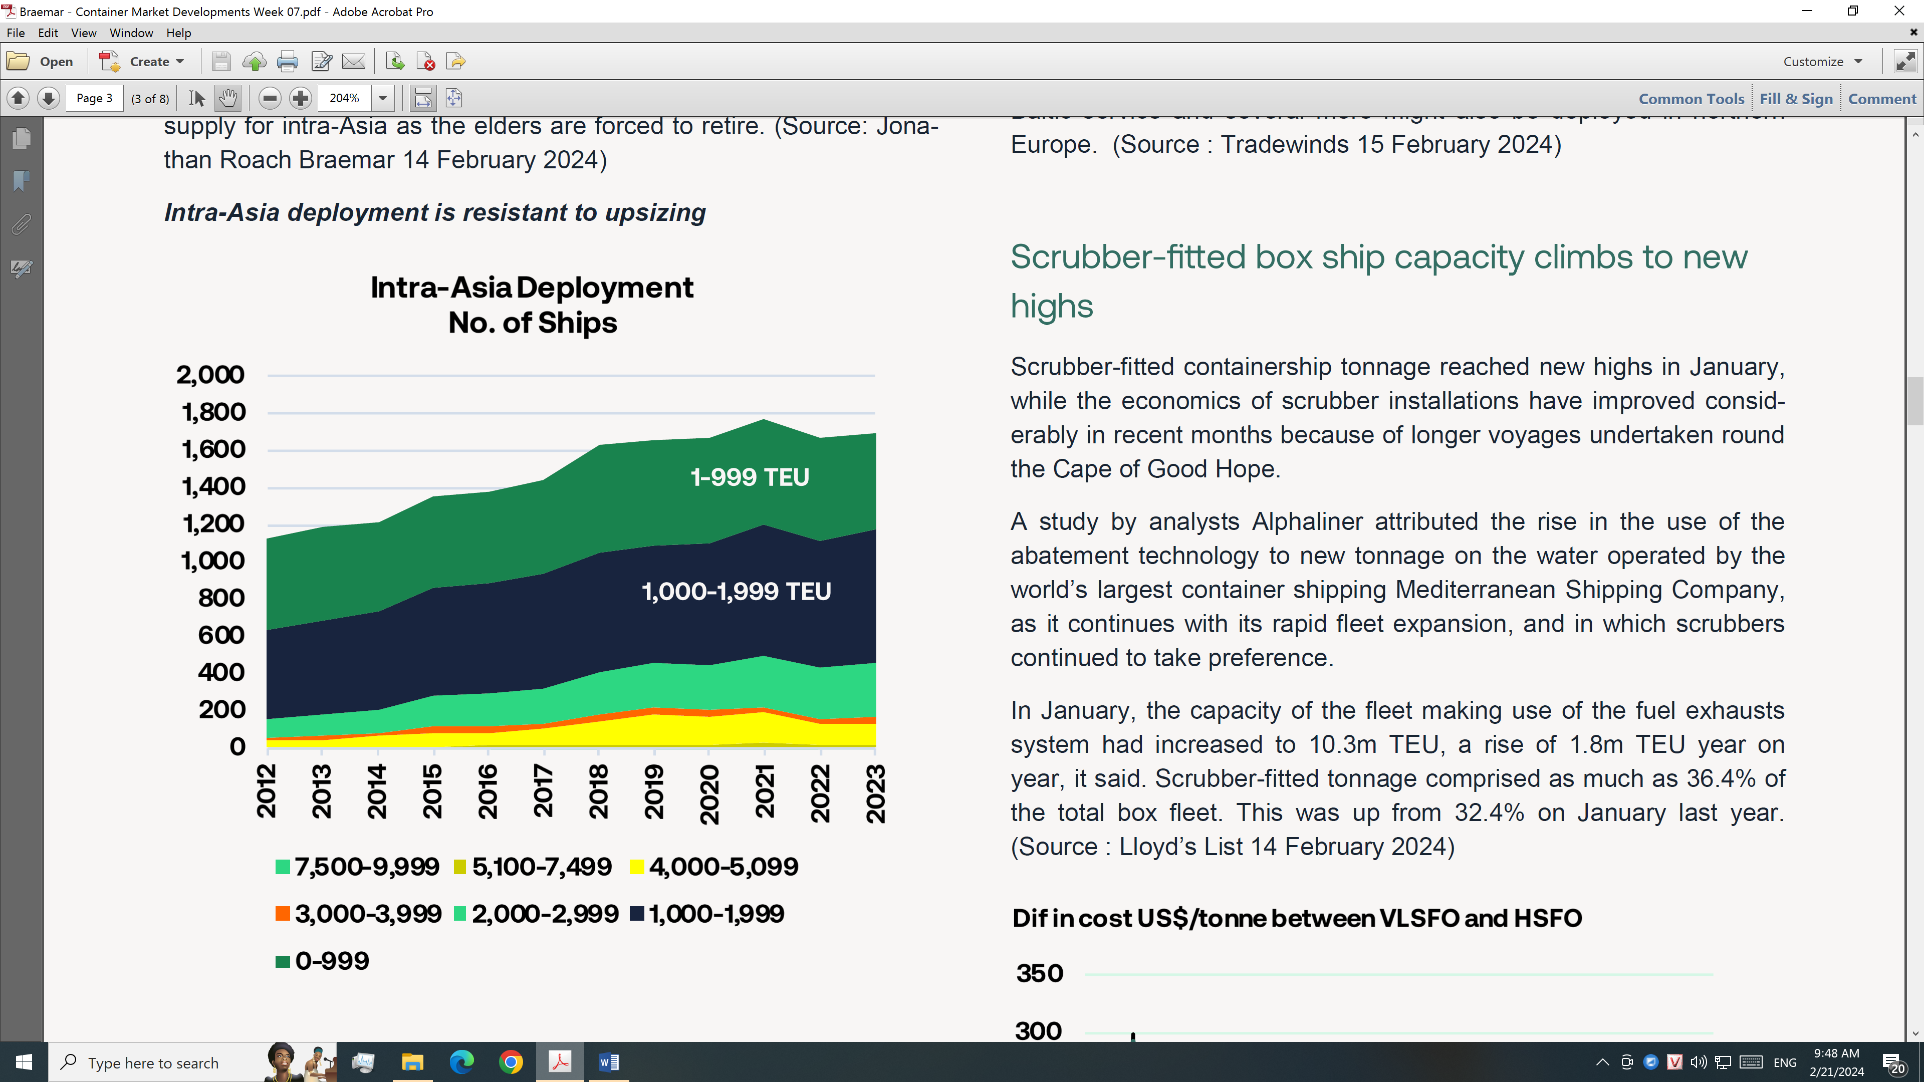
B
R
A
E
M
A
R

Slide 22
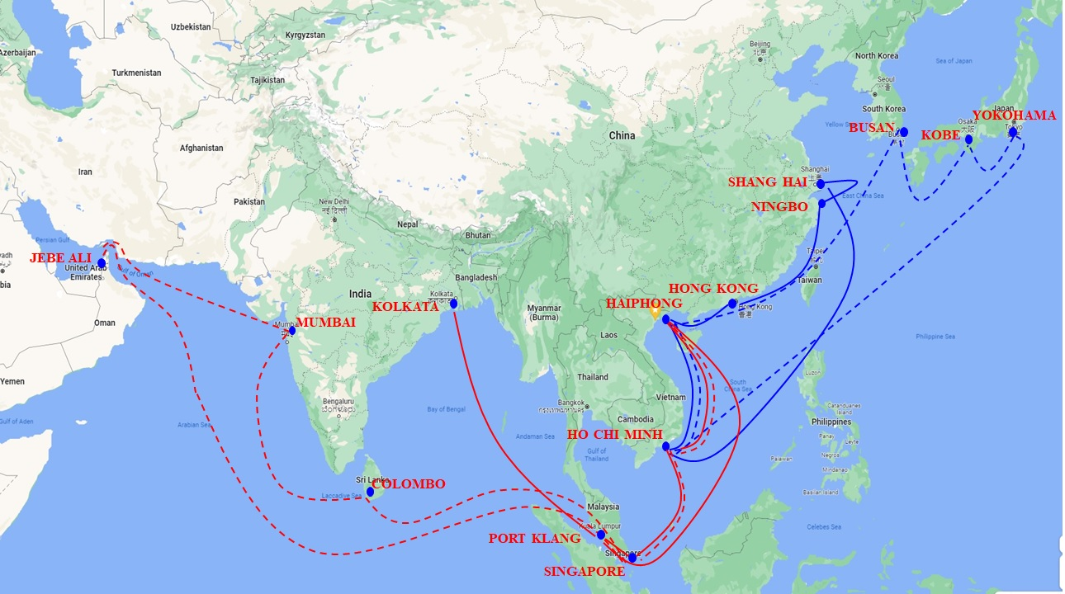
HAIAN LINES LONG TERM OF INTRA-ASIA SERVICES

Slide 23
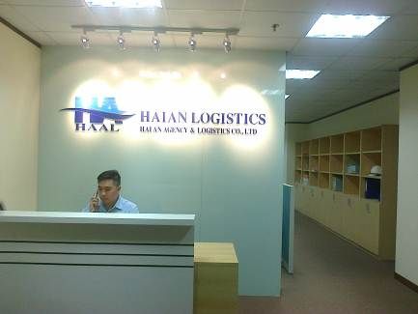
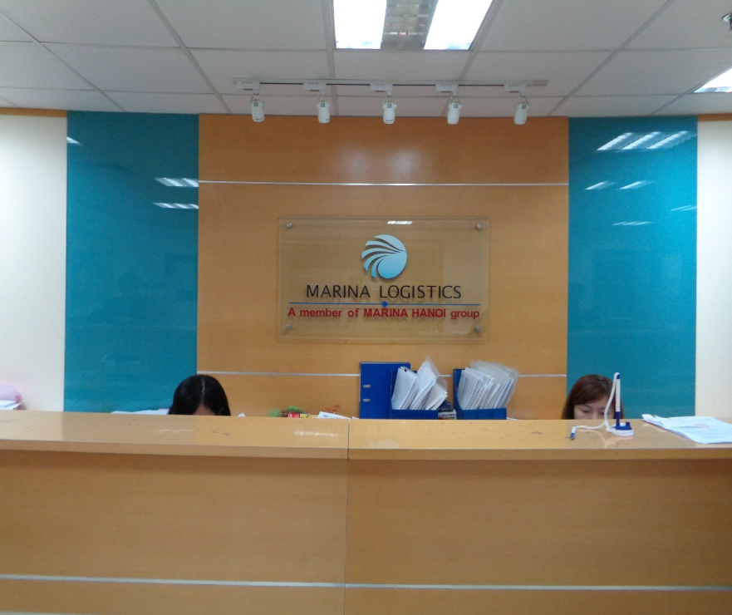
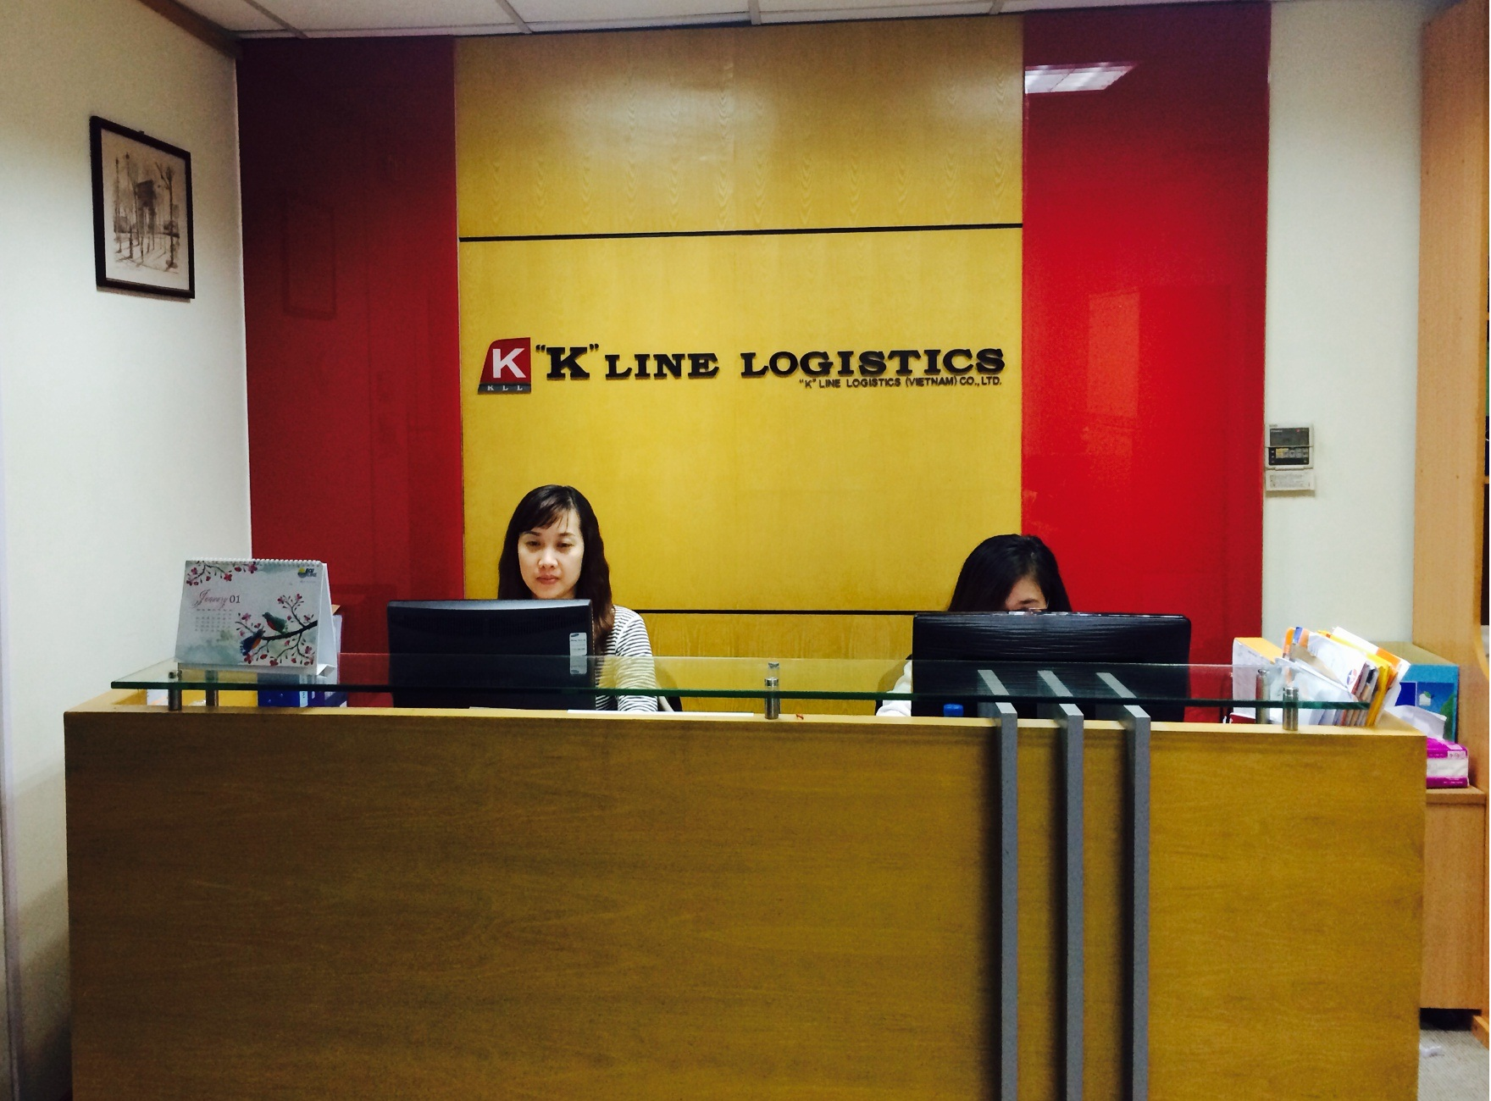
HAIAN AGENCY & LOGISTICS CO.,LTD
MARINA LOGISTICS & AGENCIES CO.,LTD
“K”LINE LOGISTICS
(VIET NAM) CO.,LTD
- Liner agent
- Logistics Provider
- Liner agent
- Logistics Provider
- Sea & Air Freight
- Logistics Provider

Slide 24
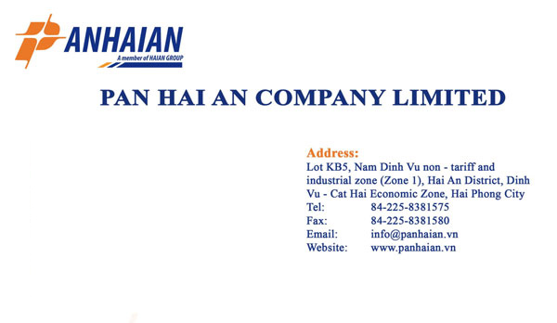
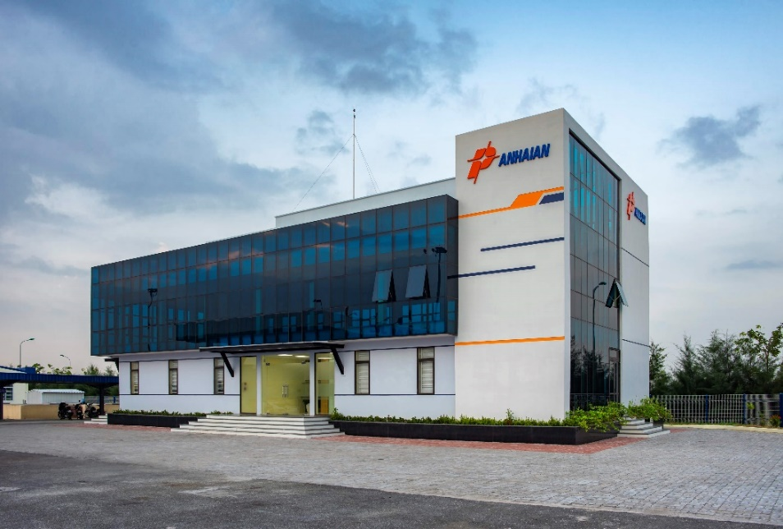
www.haiants.vn
            HaiAn Transport and Stevedoring JSC

Slide 25
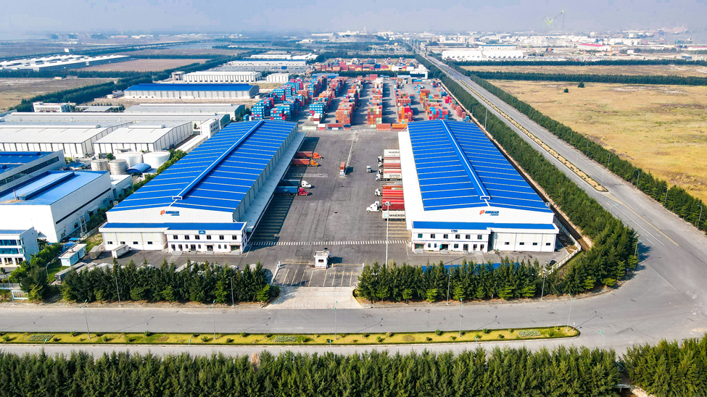
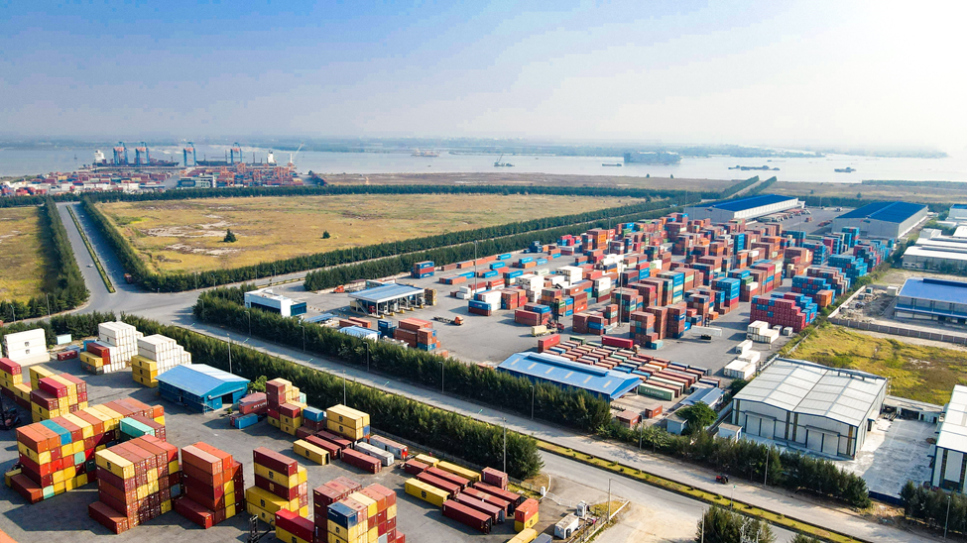
www.haiants.vn
            HaiAn Transport and Stevedoring JSC

Slide 26
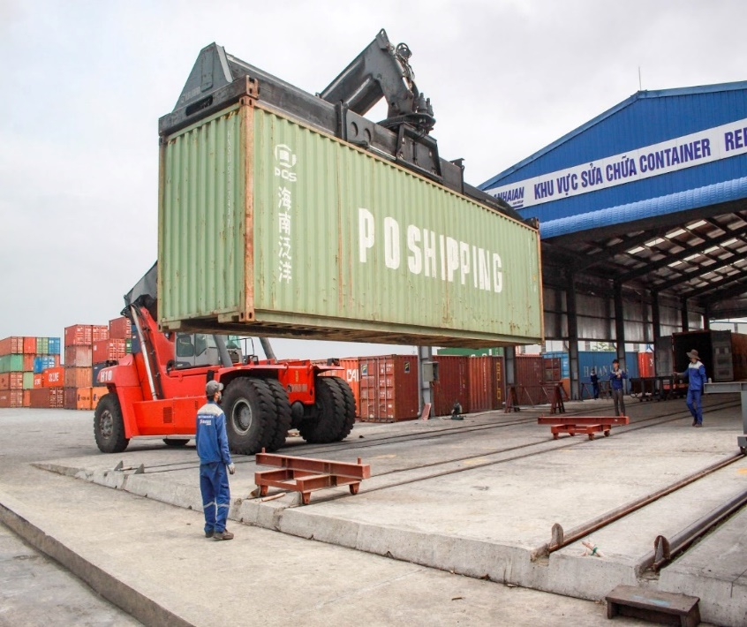
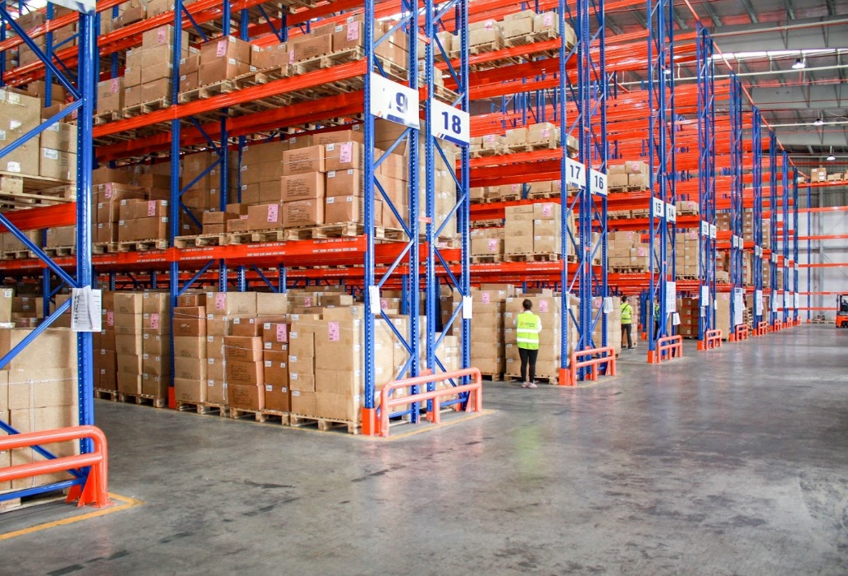
www.haiants.vn
            HaiAn Transport and Stevedoring JSC

Slide 27
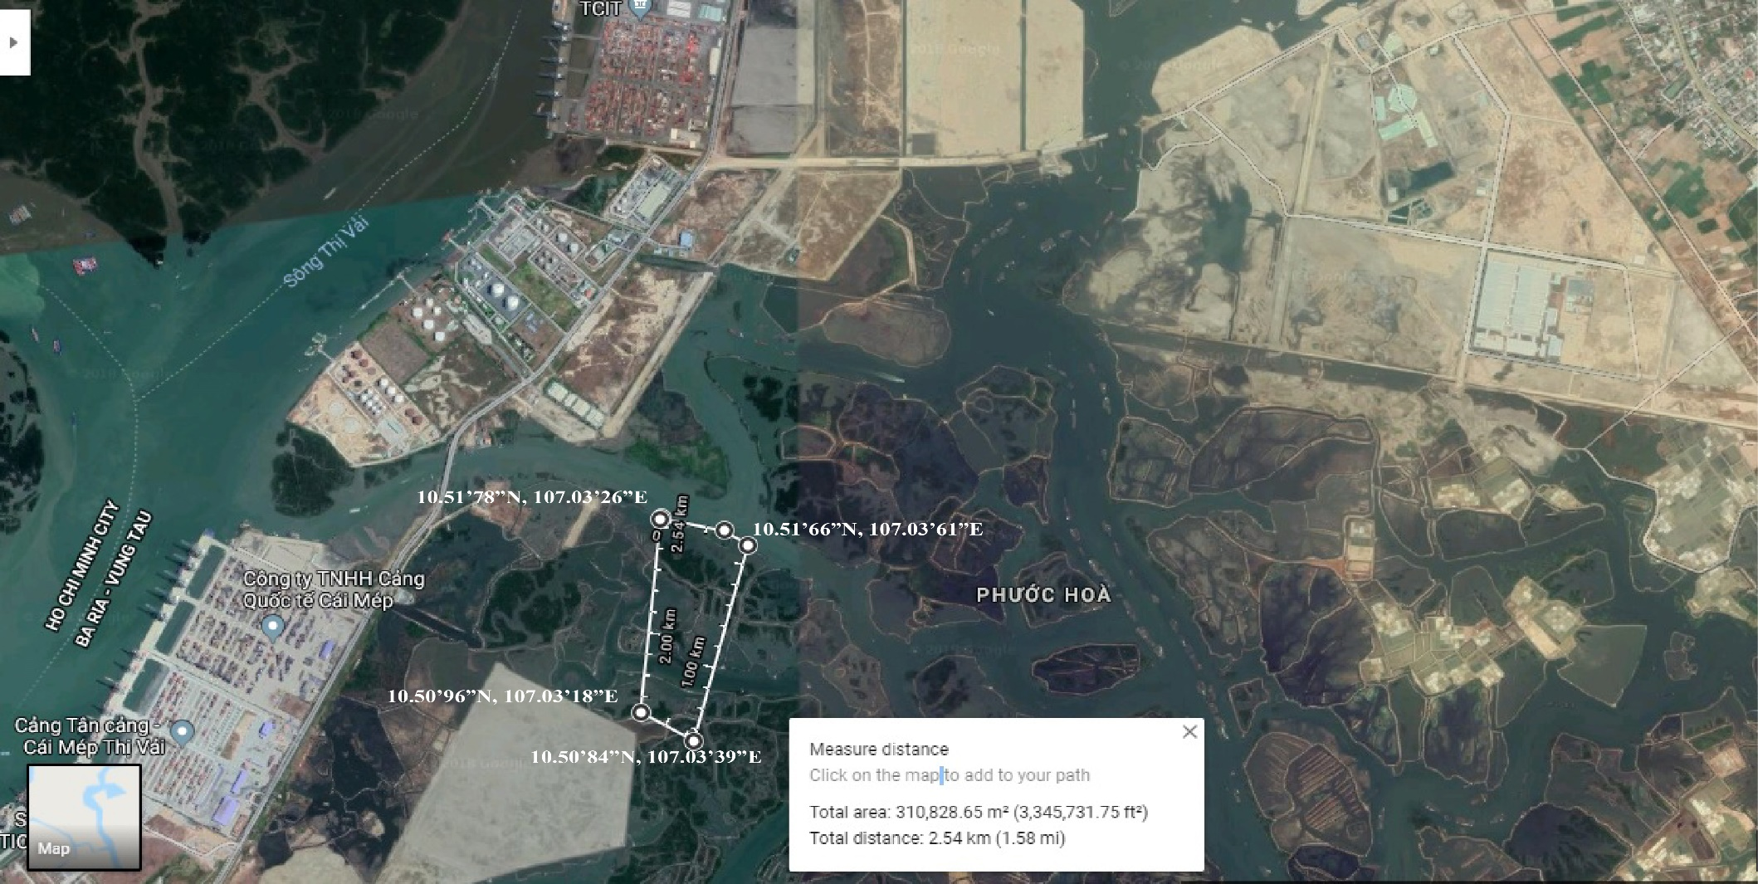
CAI MEP PROJECT

Slide 28
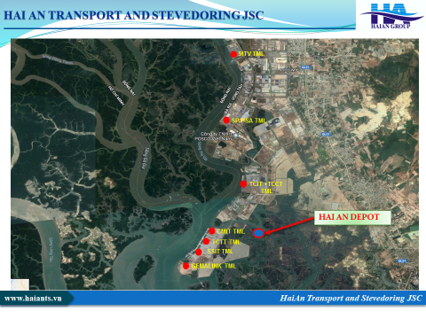

Slide 29
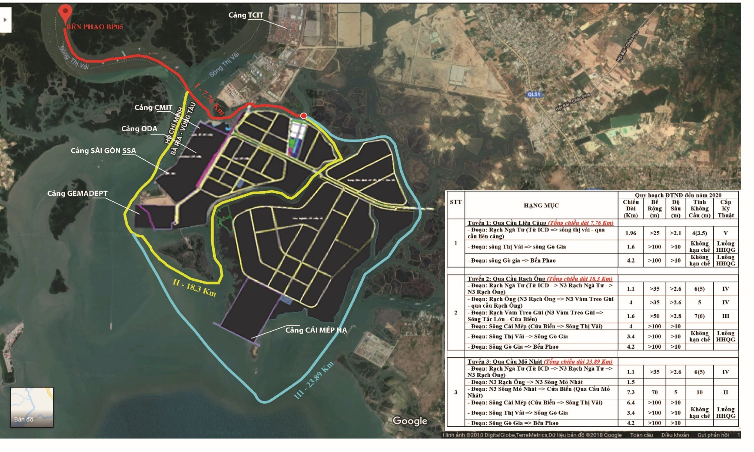
INLAND-
WATER WAY
CONNECTIONS

Slide 30
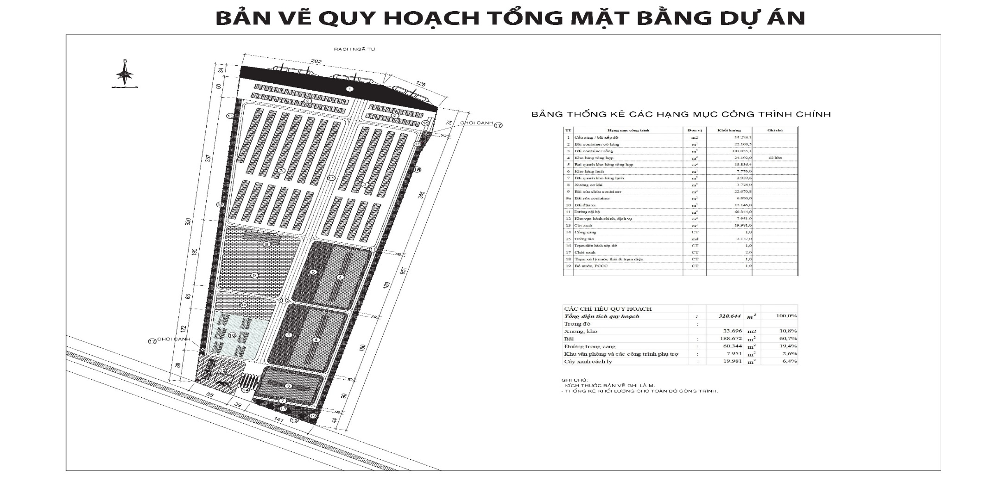
GENERAL LAYOUT OF PROJECT

Slide 31
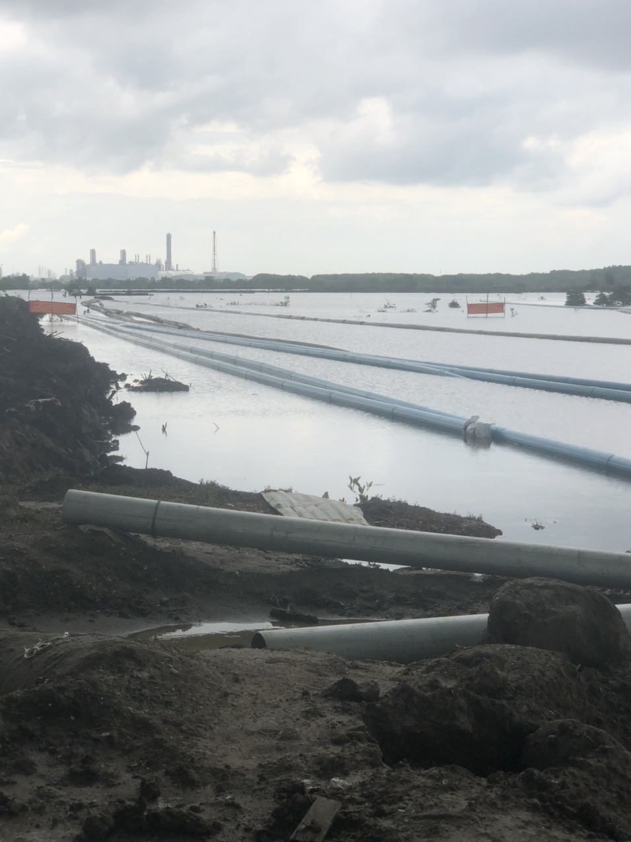
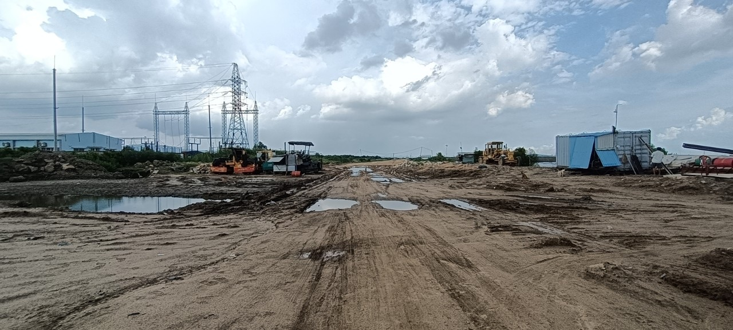
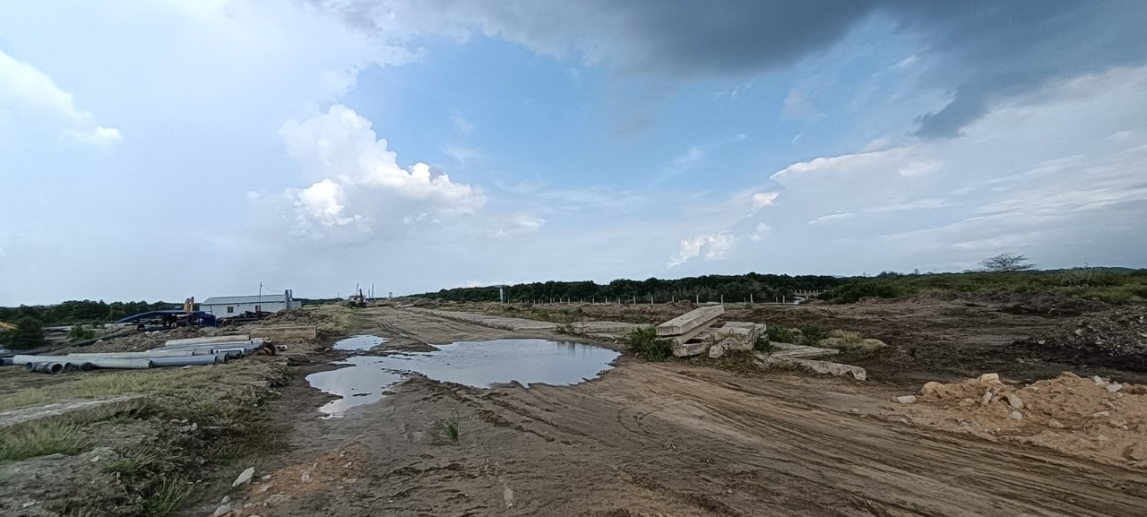
RECLAIMATION OF SITE ON PROGRESS

Slide 32
LIST OF VIETNAM CONTAINER VESSELS
Updated February. 2023

